Slide 1
Lecture 26 – Performance
2017.10.25
TANSTAAFL |’tan stä fǝl | acronym –
There ain’t no such thing as a “free lunch.”

Slide 2
Assignment for today
Midterm 2 will be entirely multiple choice

Slide 3
Measuring and reporting performance
What does it mean to say one computer or one program is faster than another?
User: the faster one runs in less time
Response time
Data center manager: the faster one completes more jobs or queries per unit time
Throughput
The common aspect is TIME: the hardware or software that performs a given amount of work in less time is the fastest

Slide 4
Comparing alternatives
The phrase “A is faster than B” means that the response time or execution time is lower on A than on B for the given task
Let “A is n times faster than B” mean Execution time_{B} = n = Performance_{A} Execution time_{A} Performance_{B}
Increasing performance decreases execution time
To avoid confusion about when “increasing” is a good thing or when “decreasing” is a good thing, use “improve performance” or “improve execution time”

Slide 5
Execution time
Wall-clock time, response time, or elapsed time: the latency to complete a task including disk accesses, memory accesses, I/O activities, O/S overhead – everything*
*Assuming that you have an executable in non-volatile storage awaiting your command; Getting to that point is another important kind of time and $$$ (programmer time/$)
UNIX time utility command example output 90.7u 12.9s 2:39 65%
90.7 seconds of User CPU time
12.9 seconds System (O/S) CPU time
2 minutes 39 seconds of Elapsed time
65% of elapsed time was CPU time for task execution
35% of elapsed time CPU was not working! Waiting for I/O or O/S has CPU running other programs, or both
Notes:
(once, of course, you have an executable in non-volatile storage awaiting your command, getting to that point is another important kind of time and $)

Slide 6
Benchmarks
Programs to help estimate performance
Should be reproducible
The closer to actual workload the better
Summarizing multiple benchmarks with a single number is hard to do well
Total execution time – clear, but ignores frequency of use of different workload programs
Weighted arithmetic mean – varies with reference
Geometric mean – consistent with normalized times, but does not predict execution time

Slide 7
Fundamental principle of performance
Make the common case fast
In making a design decision, favor the frequent case over the infrequent case
Example: overflow is rare, so optimize the ALU circuit for the non-overflow case
Challenge: determine what is the frequent case and how much performance can be improved by making it faster

Slide 8
Speedup
Performance for entire task using
Speedup = the enhancement when possible
Performance for entire task
without using the enhancement
or, reformulating in terms of what is more readily measured
Execution time for entire task
Speedup = without using the enhancement
Execution time for entire task using
the enhancement when possible

Slide 9
Speedup from enhancement
Amdahl’s Law gives overall speedup accruing from
an enhancement, which depends on two factors:
The fraction of the original computation time that the original system can take advantage of the enhancement F_{e} = Fraction_{enhanced} ≤ 1
The improvement achieved by the enhanced mode, that is, how much faster is the enhanced mode than the original mode S_{e} = Speedup_{enhanced} > 1

Slide 10
Amdahl’s Law
Speedup_{overall} = Execution time_{original}
Execution time_{enhanced}
= 1__________
Execution time_{enhanced}
= 1
( 1 – F_{e} ) + (F_{e} / S_{e})
– F_{e} + F_{e}
Fraction
unchanged
Fraction
sped up
Notes:
Amdahl's law presupposes that the computing requirements will stay the same, given increased processing power. In other words, an analysis of the same data will take less time given more computing power.
Gustafson's Law instead proposes that programmers tend to set the size of problems to use the available equipment to solve problems within a practical fixed time. Therefore, if faster (more parallel) equipment is available, larger problems can be solved in the same time.
The execution time of the program on a parallel computer is decomposed into:
where is the sequential time and is the parallel time, on any of the P processors. (Overhead is ignored.)
The key assumption of Gustafson and Barsis is that the total amount of work to be done in parallel varies linearly with the number of processors. Then practical implication is of the single processor being more capable than the single processing assignment to be executed in parallel with (typically similar) other assignments. This implies that b, the per-process parallel time, should be held fixed as P is varied.
Application in everyday computer systems[edit]
Amdahl's law reveals a limitation in, for example, the ability of multiple cores to reduce the time it takes for a computer to boot to its operating system and be ready for use. Assuming the boot process was mostly parallel, quadrupling computing power on a system that took one minute to load might reduce the boot time to just over fifteen seconds. But greater and greater parallelization would eventually fail to make bootup go any faster, if any part of the boot process were inherently sequential.
Gustafson's law argues that a fourfold increase in computing power would instead lead to a similar increase in expectations of what the system will be capable of. If the one-minute load time is acceptable to most users, then that is a starting point from which to increase the features and functions of the system. The time taken to boot to the operating system will be the same, i.e. one minute, but the new system would include more graphical or user-friendly features.

Slide 11
Amdahl’s Law example 1
An enhancement runs 10 times faster than the original and can be used 40% of the time. What is the overall speedup?
F_{e} = 0.4
S_{e} = 10
S_{overall} = 1 ( 1 – 0.4 ) + 0.4/10
= 1__ 0.64
= 1.56 or only 56% faster despite 10x
Notes:
Enhanced runs in 0.64% of the time of the original.
Speedup is 56%.
Limit of speedup given F sub e is reciprocal of (1- F sub e )

Slide 12
Amdahl’s Law example 2
Implementations of FP square root (FPSQR) vary widely in performance. Suppose FPSQR is 20% of the execution time in a critical task and FP overall is 50% of the total time. Fix #1: add FPSQR hardware to speed up 10 times. Fix #2: speed up all FP operations by 2 times. Assume equal “cost” for either fix. Which is better?
S_{FPSQR} = 1 = 1 = 1.22 ( 1 – 0.2 ) + 0.2/10 0.82
S_{All FP} = 1 = 1 = 1.33 ← better speedup ( 1 – 0.5 ) + 0.5/2 0.75

Slide 13
Connecting Amdahl’s Law to hardware
CPU = Central Processing Unit (core)
Processor Performance Equation:
CPU time = seconds for a program to execute
= Instruction count x Clock cycles per instruction x Clock cycle time
CPU time = Instructions x Clock cycles x Seconds
Program Instruction Clock cycle
For a given program and given computer:
Clock cycle time (seconds per clock cycle) depends on Hardware technology and hardware organization
Clock cycles per instruction (CPI) depends on Hardware organization and instruction set architecture
Instruction count (instructions per program) depends on Instruction set architecture and compiler technology
Notes:
This slide is all about building models. Think Pradeep Dubey.
Challenge the students to figure out the terms of the CPU time equation before revealing them. (Flipped class.)

Slide 14
Processor performance
Suppose we have the following measurements
frequency of FP operations = 25%
average CPI of FP operations = 4.0
average CPI of other instructions = 1.33
frequency of (FP square root) FPSQR = 2%
CPI of FPSQR = 20
Compare two design alternatives
decrease CPI of FPSQR to 2.0, or
decrease average CPI of all FP operations to 2.5
Compare these alternatives using the processor performance equation

Slide 15
Analysis
First, only CPI changes; clock rate and instruction count unchanged
Start by finding original, unenhanced CPI CPI_{original} = Σ CPI_{i} x ( IC_{i} / Total instruction count ) = (4 x 25%) + (1.33 x 75%) = 2.0 clocks per instruction
Compute CPI with enhanced FPSQR by subtracting saved cycles from original CPI CPI_{new FPSQR} = CPI_{original} – 2%x(CPI_{oldFPSR}– CPI_{newFPQSR}) = 2.0 – 2% x (20 –2) = 1.64

Slide 16
Analysis continued
Compute CPI with enhancement for all FP the same way, or by summing the FP and non-FP CPIs CPI_{new FP} = (25% x 2.5) + (75% x 1.33) = 1.625
CPI of overall FP enhancement is slightly lower; therefore, its performance will be marginally better
Speedup of the overall FP enhancement is Speedup_{new FP} = CPU time original / CPU time new = IC x Clock Cycle x CPI original IC x Clock Cycle x CPI new FP = CPI original / CPI new FP = 2.00 / 1.625 = 1.23
Notes:
Same result as using Amdahl’s Law on Friday.

Slide 17
Summary
Performance is measured in units of time
Amdahl’s Law shows how much overall improvement can be achieve by an enhancement applicable a fraction of the time

Slide 18
Lecture 27, 29 – Memory technology
2017.10.25-27
With today’s technology you can make memory fast, large, and affordable, as long as you pick just two.

Slide 19
Assignment for today
Midterm 2 was Lecture 28
Read chapter 10, 11, and 12
HW08 will post soon

Slide 20
CPU and memory technology overview
The transistor has been the mainstay of computer logic circuits since the 1960s
CPUs and GPUs get better along the path set forth in the International Technology Roadmap for Semiconductors, as historically predicted by Moore’s Law
Computer memory used and uses many technologies: punched paper, trapped sound, ¼-wave reflectors, (fairly) permanent magnets, capacitors, transistors, …
Thus, progress in computer memory is less predictable
Memory systems are complex
Good news: details mostly hidden from software
Bad news: performance is NOT hidden
Notes:
Bring DVD disc, punched card, core, flash, hard disk, etc.
Does this range of devices and physical phenomena sound a bit desperate?
Does is sound like science fiction?

Slide 21
Memory volatility
Volatile memory technologies
Contents (bit strings) disappear when power is removed
Often, these technologies have faster access time
Today, the “working memory” of most computers is volatile, power failure causes computer to forget what it was doing
Non-volatile memory technologies
Contents retained when power is removed
When power is restored bit strings again accessible
Some systems use a battery to create a “pseudo non-volatile” memory
Non-volatile memory is where applications and data are stored
Notes:
Bring DVD disc, punched card, core, flash, hard disk, etc.
Does this range of devices and physical phenomena sound a bit desperate?
Does is sound like science fiction?

Slide 22
Non-volatile memory type examples
Hard disk
Contents can be altered easily an infinite number of times
Flash memory
Contents can be altered easily a finite number of times (typically 10⁵ to 10⁶ times)
Used instead of hard disks when performance is goal
Notes:
Bring DVD disc, punched card, core, flash, hard disk, etc.
Does this range of devices and physical phenomena sound a bit desperate?
Does is sound like science fiction?

Slide 23
Memory density and latency
Density
Usually expressed as the total capacity of a single device, e.g., 1 Gbit chip, 1 TByte disk
For volume-sensitive devices, will refer to bits per unit area or per unit volume, depending on which makes more sense for a given technology
Latency
Time elapsed between the start of a memory operation and the completion of that operation
May depend on the preceding operation

Slide 24
Separation of read and write latency
In many memory technologies
The time required to store exceeds the time required to fetch
Difference can be dramatic
Consequence: meaningful measure of performance must give two times
Latency for reading
Latency for writing
Device datasheet must discuss whether preceding operation affects these times

Slide 25
Memory access time vs location accessed
Random access memory (RAM) – time to access any location is approximately constant
Program can access locations “at will” without a performance penalty
Sequential access – time to access a location is a function of the location to be accessed
Generally a non-linear function of location
Time to access is often called seek time

Slide 26
Non-power-of-2 memory
Some storage technologies are not inherently power of 2 oriented; examples:
Punched cards (card can be any convenient size)
Magnetic tape (tape may be any convenient length)
Floppy disks and hard disks (current feasible size)
CD, DVD, and Blu-ray (big enough to hold content)
Addressing done in appropriate terms
Device driver software performs a translation between application program “addresses” used by the CPU and addresses used by such memory

Slide 27
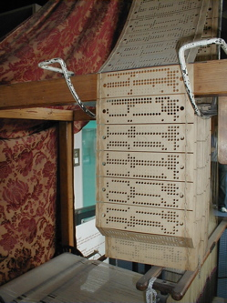

Historic memory: punched cards
Herman Hollerith invented and patented the use of punched cards for data storage (1889)
Prior use of was for control, ex., Jacquard weaving looms (1801)
Hollerith systems used for 1890 US Census
Hollerith founded Tabulating Machine Company (1896)
TMC merged with 3 others to become Computing Tabulating Recording Company (1911), which has since been renamed ?

Slide 28
Punched card tech specs
IBM set specs in 1928
Rectangular holes
80 columns; 12 punch locations & 1 char per column
7 3/8 inch by 3 ¼ inch (187.325 mm x 82.55 mm)
Hard, smooth paper 0.007 inch (180 x 10⁻⁶ m) thick
Square corners
2000 cards per box
Changes
In 1964, IBM changed from square to round corners
Fun facts
Punched cards were my non-volatile storage as an undergrad
1 million lines of code requires stack of cards 180 meters high
Notes:
Bring Mona and a punched card
Talk about card punches the size of a desk; just 4 for all of CoE; stayed up all night punching out this frivolous job (same friend played Rocket on the PDP-8 with)

Slide 29
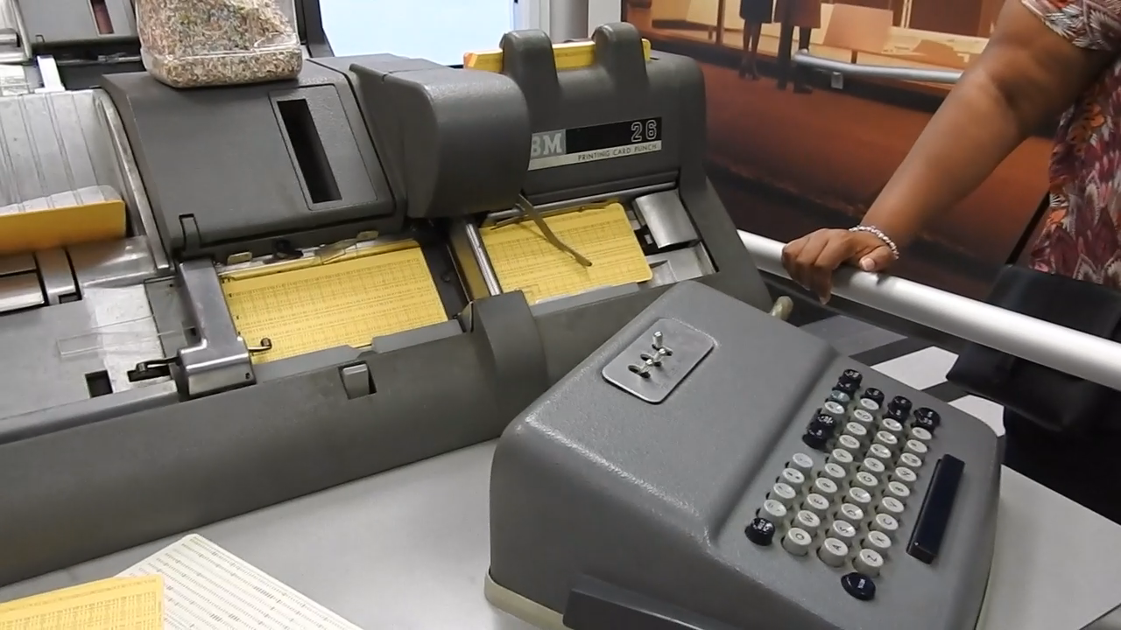
Punching punched cards

Slide 30
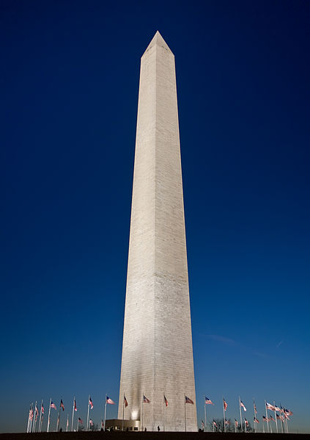
1,000,000 lines of code on cards
Punched cards
Washington monument
1,000,000
169 m
180 m
Photo by DAVID ILIFF. License: CC-BY-SA 3.0

Slide 31
Historic: Sequential access memory
Delay line (bits arranged in a conga line)
Literally “shout out bits” at point A sending them along a slow transport path to point B some distance away
Listen to the shout at point B and loop the bits back to A via a much faster transport path
Keep the loop going as long as you want the bits in memory
Speed ratio allows many bits to be in transit along slow path
Examples:
mercury-filled acoustic tubes
coiled fiber optic cable
Magnetic tape
Magnetize particles attached to a moving plastic film
Access a particular memory location on the tape
Start up time
“Cruising” time to the location; may be quite a while
Read or write at the location

Slide 32
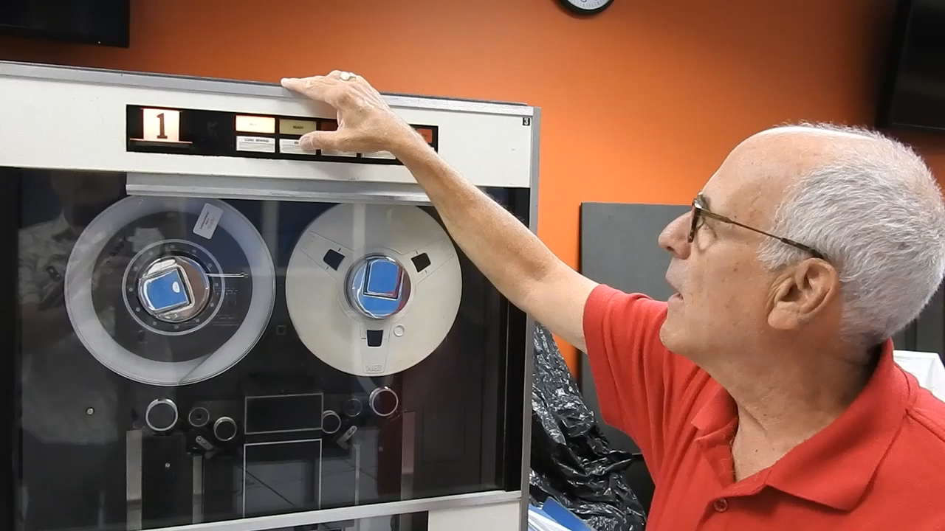
Historic magnetic tape
Video © George Adams, 07 July 2017. Filmed at the Computer History Museum, Mountain View, CA with the gracious help of Ken Ross, docent.

Slide 33
Magnetic tape specs yesterday and today
1952: first IBM tape drive
Magnetic particle slurry applied to plastic film and dried
Areal read/write density of 1,400 bits per square inch
Capacity of 1 tape approximately 2.3 Mbytes
2017: IBM Research and Sony Storage Media Solutions demonstrate
Multi-layer sputtered media tape; 103x31 nanometer bit
Areal density 201 gigabits per square inch
Capacity of palm-sized cartridge is 330 terabytes
Cost per bit stored for tape << hard disk or flash memory
Tape remains relevant today for massive archives with infrequent accesses

Slide 34
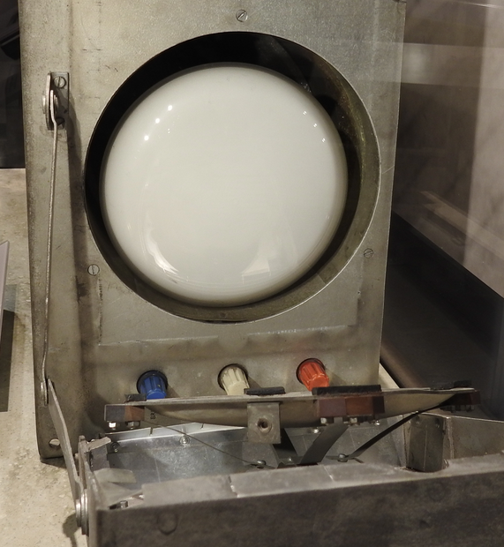
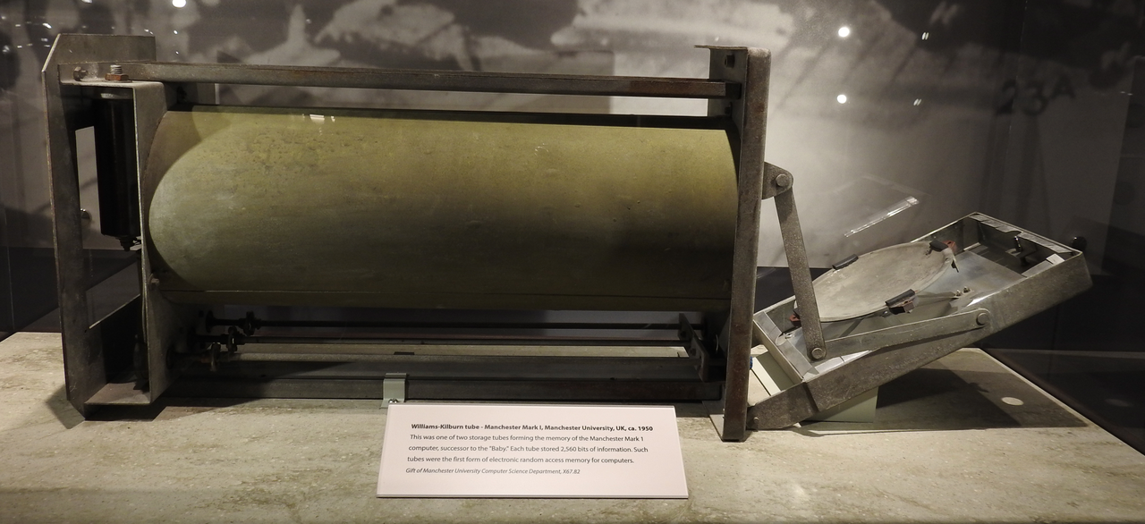
Historic: first random access memory, Williams tube, same concept as DRAM
Bits stored as a circa 2¹⁰ to 2¹¹ array of charged spots created by an electron gun at left on white phosphor at right. Volatile memory.

Slide 35
Historic: Core memory (~1955 – 1975)
Each bit stored as a direction, clockwise (CW) or counter-clockwise (CCW) of magnetization within a ferrite toroid; a true digital media
Non-volatile, plus EMP and radiation “hard”
Origin of the term “core dump”
Interesting characteristic: Reading a location is done by trying to reset that bit to 0 (called destructive read); Must re-write 1 bits after reading them, 0 bits survive reading
^{CW}
_{CCW}

Slide 36
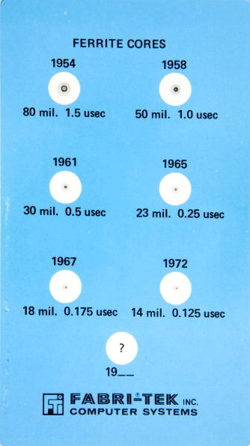
Evolution of ferrite cores
1 mil = 10⁻³ inch = 0.0254 mm
usec = microsecond = 10⁻⁶ sec
Cost initially, $1/bit, eventually $0.01/bit
Williams tubes were finicky, unreliable; had access times circa 25 microseconds
Core was more reliable and considerably faster
Core has no wear mechanism; infinite life, like transistors

Slide 37
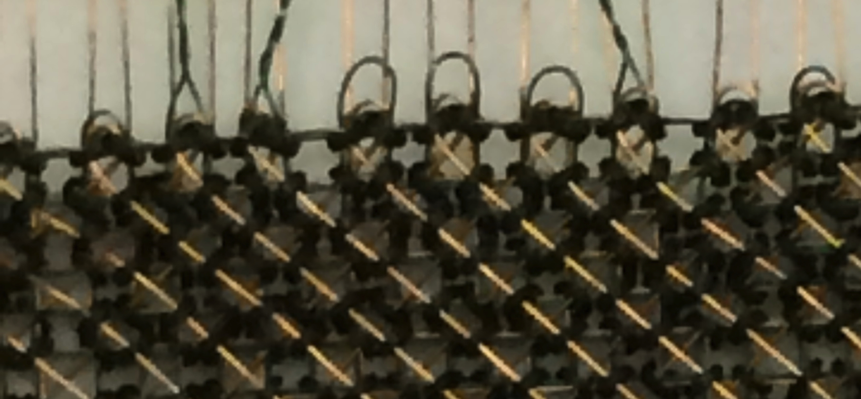
Close up of CDC6600 main memory core “plane.”
Used at Purdue for many years. Cores threaded by hand while viewing them under a microscope. Manufacture was never successfully automated.

Slide 38
Who invented core memory? (from Computer History Museum, Mountain View, CA)
They say “Success has a thousand parents”, or in this case, at least, four
Amateur inventor (and street inspector for Los Angeles) Frederick Viehe filed a core memory patent in 1947
Harvard physicist An Wang filed one in 1949
RCA’s Jan Rajchman filed a patent in 1950; used an aspirin pill press to make his cores
MIT’s Jay Forrester filed in 1951 showed how to use “coincident current” to address bits

Slide 39
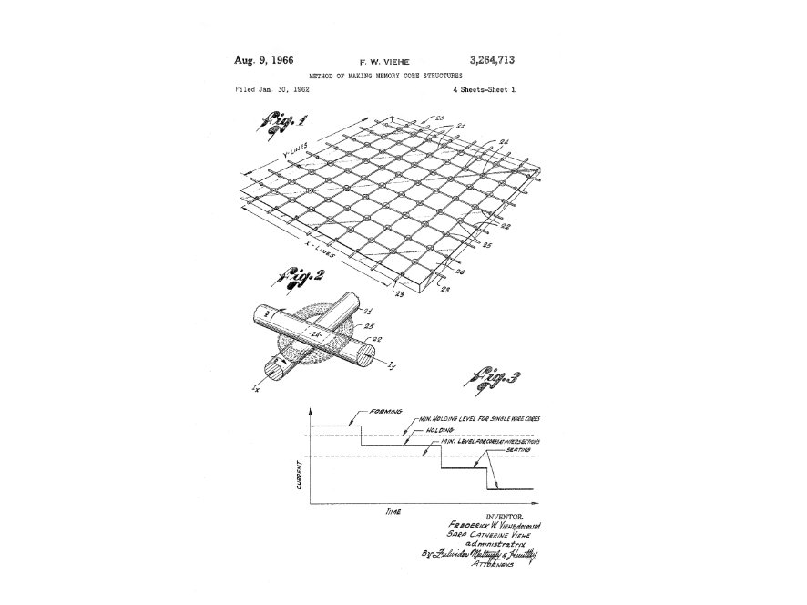
Viehe patent diagram

Slide 40
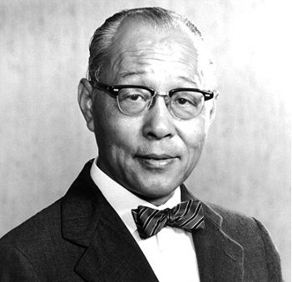
Core memory patent acquisition by IBM
Core memory proved extraordinarily successful and profitable for IBM
1955 IBM buys An Wang’s patent for $500,000; Wang used this to greatly expand Wang Laboratories
1956 IBM buys Viehe’s patent from his widow
1964, after years of legal wrangling, IBM buys the Forrester patent for $13,000,000; most to that date for any patent

Slide 41
How cores work: 2D addressing
Each core and the bit that it stores is addressed by the 1 horizontal (H) and 1 vertical (V) wire that cross within it
To address 2^{k} bits use the 2^{k} intersections of 2^{k/2} H wires and 2^{k/2} V wires
Note: 2^{k/2} = √2^{k} so two-dimensional physical layout allows using two much smaller decoders in parallel (simultaneously) to point to a bit at the intersection of the selected row and independently selected column

Slide 42
Semiconductor memory
Memory built using the same chip fabrication process as for semiconductor logic circuits
Various forms
Relatively fast
Volatile
Random access
Each bit is stored in a memory cell circuit
Different memory cell types correspond to different families of semiconductor memory

Slide 43
Modern memory: Static RAM for cache
Static RAM (SRAM) used late 1960s to now
Data is “static,” or remembered, as long as circuit is powered on
SRAM is a volatile memory technology that forgets when power is turned off
Access speed is near CPU logic gate speed
Today, SRAM is found mostly on-chip physically next to the processor circuit as cache memory

Slide 44
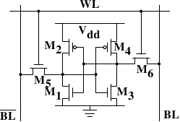
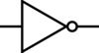
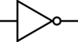
SRAM memory cell circuit
SRAM cell is an inverter latch circuit plus buffers
Uses 6 transistors to store one bit
Bit Line (in and out)
(in and out)
______
Bit Line (in and out)
(in and out)
Notes:
NEED TO COLORIZE and RE_ANIMATE HERE from the old slide.

Slide 45
SRAM layout on semiconductor chip
SRAM bit array circuit; access is by word
Address bits
Word line decoder
…
Data out/in on bit lines (BL) via mux/demux

Slide 46
Advantages and disadvantages of SRAM
Advantages
True digital behavior: same as logic gates
High speed: similar to speed of NAND latch
Access: decoder, plus mux/demux for out/in and to select bits from word if word too large
Disadvantages
High power consumption per bit; same as latch
High heat generation, thus high cost: a chip of SRAM requires expensive package to remove heat
Modest number of bits per unit of chip area

Slide 47
Today’s memory: Dynamic RAM (DRAM)
Logic 1 represented by charge, not voltage
Memory cell is 1 transistor and 1 capacitor (analogous to a Williams tube)
Memory cell is smaller, much cooler than SRAM
Stored charge leaks fast (~10 msec at room temp)
Must refresh data, unlike a latch circuit
DRAM much slower than SRAM
Sensing charge presence/absence takes more time than sensing high/low voltage
1972: Intel 1103 chip at $0.01/bit; displaced core memory in a few years

Slide 48
DRAM refresh
Refresh process algorithm
While (1)
Read contents of location K
Write contents of location K into location K, thus recharging the 1 bits in location K
K = (K+1) modulo 2^{number of address bits}
Refresh
Runs “in the background” with respect to program read and write actions
Must not cause program correctness issues
Uses a small amount of energy constantly

Slide 49
DRAM redundancy
After chips reached 64 Kbit capacity manufacturers started including spare row(s) and column(s)
As number of cells increased, probability of a bad cell tended to increase as well
Row/column spare(s) allow “map out” of bad bit(s) during chip testing
Decoder circuit enhanced to be able to substitute in spare row(s) and column(s) and avoid bad row(s)/column(s) by at-factory programming
Avoids having to discard a chip with a single bad memory cell and no redundancy
Notes:
BUILD DRAM MEMORY CELL CIRCUIT HERE

Slide 50
Flash memory
Memory cell is a single transistor with a well insulated “floating gate” serving as a very low leakage capacitor
Flash is non-volatile storage: bits leak away only after years, perhaps decades; no refresh needed, thus no power needed
Number of charge levels used in the capacitor may be 2, 4, and even 8 (1-bit, 2-bits, 3-bits) per one memory cell
High demand has supported intensive commercial efforts to improve this technology

Slide 51
Flash advantages and disadvantages
Advantages
Density and cost have improved rapidly
Speed, power consumption, noise all better than hard disk drives
Disadvantages
Limited number of program/erase cycles for each bit, typically 10^5 perhaps 10^6 due to memory cell wear
Read, write, and erase operations are all different and all quite complex
Reading a location disturbs adjacent locations: must count accesses and “refresh” data after some number of reads
Must engage in wear-leveling management
Must map out bad (failed) locations dynamically

Slide 52
Hard disk drive
Introduced in 1956 by IBM, and still going strong
Magnetic data storage, like core, but magnetic media is a thin continuous film coating on a rotating surface
Media is fine powder in a binder (a paint) with analog behavior
Rotating cylinder, called a drum, with multiple, fixed heads used in the past
Rotating disk (platter) with moving read/write head today
Media has no wear mechanism, permitting
Infinite read/write cycles
No need for wear leveling
High storage density today of ~1 Tbit/inch² requires exceptional mechanical parts precision
Retractable heads and removable platter stacks used in the past when density and mechanical precision was much lower

Slide 53
Open up a 2.5” hard disk
Toshiba model HDD2134
4327 MB capacity
On 2 platters with 4 surfaces (top & bottom each)
with 4 read/write heads, that move in tandem to position over any 1 of
8944 concentric tracks on a platter
A set of corresponding tracks across all platters is called a cylinder; all data contained by a cylinder can be read/written without moving the heads
Notes:
Start here Wednesday.

Slide 54
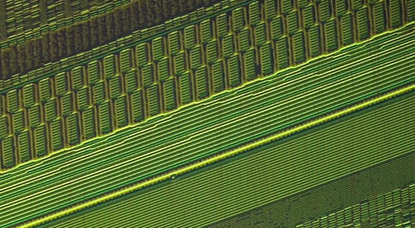
Hard disk platter – magnetic regions
By Matesy GmbH (Own work) [CC-BY-SA-3.0 (http://creativecommons.org/licenses/by-sa/3.0)],
via Wikimedia Commons. https://commons.wikimedia.org/wiki/File%3AAufnahme_einzelner_
Magnetisierungen_gespeicherter_Bits_auf_einem_Festplatten-Platter..jpg

Slide 55
Hard disk latency
To reach a given location on a platter inside a hard disk
The read/write heads must be positioned accurately enough over the intended track and
The platter must rotate until the desired data is just coming under the head
Then the data can stream in or out.
Spindle RPM | Ave Rotational Latency (msec) | Improvement
5400 | 5.56 | 0%
7200 | 4.17 | 33%
10000 | 3.00 | 85%
15000 | 2.00 | 178%

Slide 56
Typical values for hard disks
Average track-to-track seek time ~8 milliseconds
Read/write head moves ~1 cm
Head assembly accelerates at ~200 g, coasts for ~1 ms, and decelerates at ~250 g
Heads oscillate a few times back and forth across the destination track before they settle enough
Must settle to ±15% of on-center of the track to read with low probability of error, to within ±10% to write without running risk of overwriting (destroying) data on an adjacent track

Slide 57
Hard disk drive key trends and technologies
Platter diameters shrink with increasing bit density, but small platters increase diameter to avoid competing with Flash memory
Resulting “high/low” squeeze means only two hard disk diameters are in production today
3.5 inch for desktop and warehouse-scale computers
2.5 inch for laptop computers
Disk data read signal (analog) has very poor quality
Tiny magnetic field from the area recording a bit induces a small voltage in read head compared to other voltages induced by nearby bits and background media “noise” magnetization
Signal processing “detector” technology is crucial to converting analog read signal, comprised of data plus error detecting and correcting codes, to a sufficient quality digital data stream
Then, fixed algorithms in hardware process the digital data stream using codes to correct detected errors
8+ % of disk storage space is devoted to redundancy to permit error detection and correction
Notes:
Illiac IV platters were ~ 4feet in diameter.
Marvel Technology Group, LLC paid $750 M settlement in February 2016 to CMU and inventors for rights to a patent for an optimal detector technology used in the majority of disk drives today

Slide 58
Hard disk advantages & disadvantages
Advantages
Inexpensive, around $0.03 per gigabyte
Dense, around 10 TBytes in 30 cm^3
Disadvantages
Slow, around 8 milliseconds to access
Sensitive to mechanical shock when operating
Power less than SRAM, more than DRAM or Flash

Slide 59
Future memory technology in development
RRAM: molecular-scale material phase change
Bit stored as a changed resistance
Non-volatile
Speed may be just a few nanoseconds
Might not be wear-limited
Names: memristor, phase-change memory, conductive bridging RAM
Flash
Continuing price reduction in today’s NAND-type Flash will further squeeze hard disk drives out of performance-sensitive applications
Many variations on NAND-type Flash memory are under development; no obvious successors
Notes:
Millipede memory: Atomic-scale “punched card” with scanning probe microscope read/write

Slide 60
Summary
Memory is now far cheaper, denser, and smaller, and lower power than ever before
Modest progress on access time (speed)
Moore’s Law improvement of MOSFET logic gate circuit speed for CPUs/GPUs far outpaced memory speed improvement over the same period
Achieving high effective performance with current memory technology requires a complex memory system design

